Slide 1
Let’s start: What is this?
Past
(best circa
2012)
Early
2015
Today
2017
DPM
(Pre DL)
Fast R-CNN
(AlexNet)
Fast R-CNN
(VGG-16)
Faster R-CNN
(ResNet-50)
Faster R-CNN
(R-101-FPN)
Mask R-CNN
(X-152-FPN)
Notes:
Now I want to describe what this method, Mask R-CNN, looks like
But it’s actually the fourth generation in a line of object detection systems that I’ve been developing with my colaborators
In order to explain it, I need to walk through the progression

Slide 2
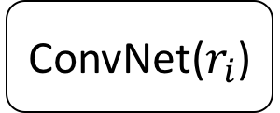
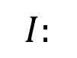
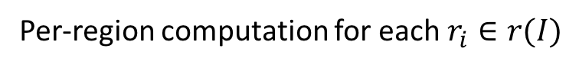
“Slow” R-CNN
Girshick, Donahue, Darrell, Malik. Rich Feature Hierarchies for
Accurate Object Detection and Semantic Segmentation. CVPR 2014.
Per-image computation
Per-region computation for each $r_{i}∈r(I)$
1-vs-rest SVMs
$$I:$$
Crop & warp
ConvNet($r_{i}$)
4
2
3
Box regressor
Selective search,
Edge Boxes,
MCG, …
5
1
Notes:
Let’s start with the first model, which is called R-CNN
For reasons that will become obvious in a moment, I’ll refer to it as “slow” R-CNN
This was one of the first deep learning based object detection systems after AlexNet was published and works in the following very simple way
First, an object proposal algorithm is used to generate candidate rectangles for where object might exist in the image. There are a lot of these algorithms, such as selective search, edge boxes, and MCG. This stage aims for recall and a typical number of proposals is 2000 per image
Second, each the image under each proposal is extracted by cropping and warping the crop to a fixed square size
Third, the patch is fed through a trained ConvNet to produce a feature vector. Originally we used AlexNet, but this can be your favorite network.
Finally, the feature vector is used to classify the proposal as one of the 80 categories or background and a regressor is used to predict a refined spatial extent of the object

Slide 3
“Slow” R-CNN
Per-image computation
Per-region computation for each $r_{i}∈r(I)$
1-vs-rest SVMs
$$I:$$
Crop & warp
ConvNet($r_{i}$)
4
2
3
Box regressor
Selective search,
Edge Boxes,
MCG, …
5
Very heavy per-region computation
E.g., 2000 full network evaluations
1
Notes:
This diagram has two sides, the left side in light yellow shading has computation that’s done once per image
The right side, in green shading, has computation that’s performed once per proposal
And that’s why this method is pretty slow, because it requires a full network evaluation for each cropped proposal

Slide 4
“Slow” R-CNN
Per-image computation
Per-region computation for each $r_{i}∈r(I)$
Identity
1-vs-rest SVMs
$$I:$$
Crop & warp
ConvNet($r_{i}$)
Box regressor
Selective search,
Edge Boxes,
MCG, …
Notes:
Now we can fix this problem of slowness, but in order to explain how, I want to first give an abstracted or generalized presentation of the model
First I’m going to start by modifying the diagram to include duplication of the input image, which doesn’t change anything

Slide 5
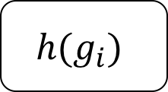
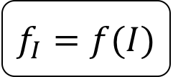
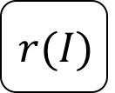
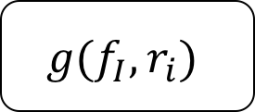
Generalized R-CNN Approach to Detection
Per-image computation
Per-region computation for each $r_{i}∈r(I)$
$$f_{I}=f(I)$$
Classification
$$I:$$
$$g(f_{I}, r_{i})$$
$$h(g_{i})$$
.
.
.
Box regressor
$$r(I)$$
Notes:
Now we’re going to replace the particular implementations of many components with unspecified functions

Slide 6
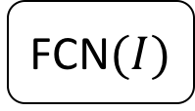
Fast R-CNN
Girshick. Fast R-CNN. ICCV 2015.
Per-image computation
Per-region computation for each $r_{i}∈r(I)$
FCN$(I)$
Softmax clf.
$$I:$$
RoIPool
MLP
Box regressor
Selective search,
Edge Boxes,
MCG, …
Lightweight per-region computation
Notes:
Now the next model, called Fast R-CNN, is instantiated by making a particular set of choices for these unspecified components
The proposal mechanism is the same as before, but the rest have changed
The goal of these changes is to maintain accuracy, while shifting computation from the per-region side to the per-image side in order to make the model fast
Let’s go through them

Slide 7
Fast R-CNN
Per-image computation
Per-region computation for each $r_{i}∈r(I)$
FCN$(I)$
Softmax clf.
$$I:$$
RoIPool
MLP
Box regressor
Selective search,
Edge Boxes,
MCG, …
Notes:
First, we have fully-convolutional network that transforms the image I into a multi-channel feature map

Slide 8
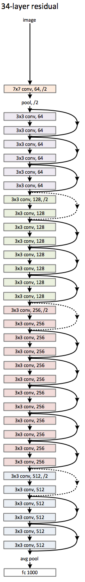
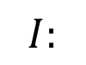
Whole-image FCN
Example:
ResNet-34
Use any standard ConvNet as the “backbone architecture”
AlexNet, VGG, ResNet, Inception, Inception-ResNet, ResNeXt, DenseNet, …
Use the first N layers with spatial extent (e.g., up to “conv5”)
Example feature map
dimensions:
(512, H/16, W/16)
$$I:$$
FCN$(I)$
Notes:
This FCN can be any standard ConvNet in practice, like AlexNet, VGG, ResNet, and so on
Importantly, the network used here needs to contain only layers that preserve a spatial layout of the features
Typically one will do this by taking only the layers up to a certain point from one of these networks
The result will be a multi-channel feature map, like in this case one with 512 channels and a height and width that are 1/16 that of the original image

Slide 9
Fast R-CNN
Per-image computation
Per-region computation for each $r_{i}∈r(I)$
FCN$(I)$
Softmax clf.
$$I:$$
RoIPool
MLP
Box regressor
Selective search,
Edge Boxes,
MCG, …
Notes:
Now the second component to look at is that crop and warp has been replaced by Region of Interest, or RoI, pooling

Slide 10
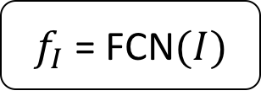
RoIPool (on each Proposal)
Transform arbitrary size proposal into a fixed-dimensional representation (e.g., 2x2)
$f_{I}$ = FCN$(I)$
Proposal
Region of
Interest
(RoI)
(Variable size RoI)
Notes:
The objective of this operation is transform the features under an object proposal, which have arbitrary rectangular shape into a fixed dimensional representation
To do that, the region of interest is projected into the feature map’s coordinate frame and since the end goal is to output a 2x2 feature map, we’ve divided the proposal into a 2x2 grid

Slide 11
RoIPool (on each Proposal)
Transform arbitrary size proposal into a fixed-dimensional representation (e.g., 2x2)
Snapped RoI
$f_{I}$ = FCN$(I)$
Proposal
Region of
Interest
(RoI)
(Variable size RoI)
Notes:
We’ll come back to this later, but implementation of RoIPool used in this work involved rounding the coordinates of the grid bins so they match with the integer coordinates of the feature map

Slide 12
RoIPool (on each Proposal)
Transform arbitrary size proposal into a fixed-dimensional representation (e.g., 2x2)
Snapped RoI
(Fixed dimensional
representation)
$f_{I}$ = FCN$(I)$
RoIPool
transform
Proposal
Region of
Interest
(RoI)
Feature value
is max over input
cells
(Variable size RoI)
Notes:
Once the proposal is snapped to the feature grid, max pooling is applied to each bin in the 2x2 grid to compute final features

Slide 13
Fast R-CNN
Per-image computation
Per-region computation for each $r_{i}∈r(I)$
FCN$(I)$
Softmax clf.
$$I:$$
RoIPool
MLP
Box regressor
Selective search,
Edge Boxes,
MCG, …
Region proposals have very poor recall
(ok for PASCAL VOC, major bottleneck for COCO)
Also, they can be slow
Notes:
Fast R-CNN still has a major shortcoming, which is that it relies on region proposal methods that in practice are not very good
On a dataset like COCO, they have very low recall and become of the bottleneck of the detector
Unlike the rest of the system, these methods use minimal learning
They can also be slow, often taking much more time than the rest of the system

Slide 14
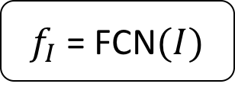
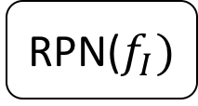
Faster R-CNN
Ren, He, Girshick, Sun. Faster R-CNN: Towards Real-Time Object Detection. NIPS 2015.
Per-image computation
Per-region computation for each $r_{i}∈r(I)$
$f_{I}$ = FCN$(I)$
Softmax clf.
$$I:$$
RoIPool
MLP
.
.
.
Box regressor
RPN($f_{I})$
Learned proposals
Sharing computation with whole-image network
Notes:
To address this problem, the next model introduces a Region Proposal Network, or RPN, that can learn the proposals
It also shared almost all of its computation with the whole-image FCN, which makes it very efficient

Slide 15
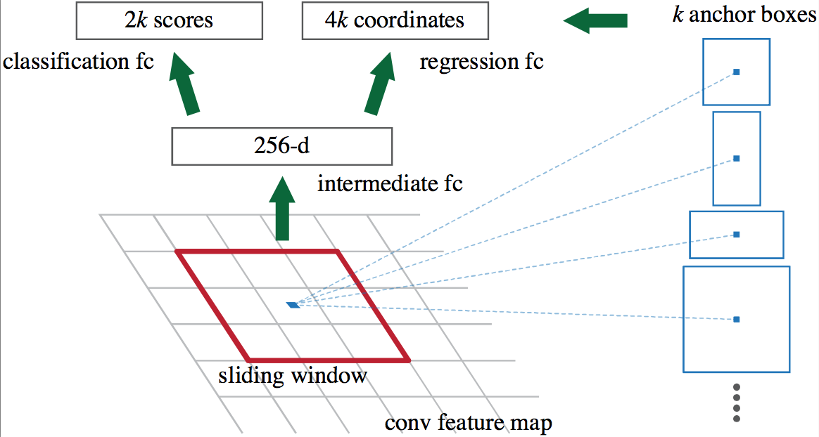
Region Proposal Network (RPN)
Proposals = sliding window object/not-object classifier + box regression
inside the same network
(Shared over
FPN levels)
Anchors are prototypical object boxes
$f_{I}$ = FCN$(I)$
Notes:
RPN takes as input the feature map output by the whole-image FCN
It then runs a very small network in a sliding window fashion over the feature map
At each location it makes predictions for the presence or absence of an object (of any category) and it also predicts the spatial extent of the object if there is one
To make it more effective, rather than making one prediction at each location it actually makes k
Each of the k predictions is relative to an anchor box, which specifies a canonical object scale and aspect ratio

Slide 16
Mask R-CNN
He, Gkioxari, Dollár, Girshick.
Mask R-CNN. ICCV 2017.
Per-image computation
Per-region computation for each $r_{i}∈r(I)$
Softmax clf.
$f_{I}$ = FCN$(I)$
MLP
Box regressor
$$I:$$
RoIAlign
Mask FCN
RPN($f_{I})$
Notes:
Finally we come to Mask R-CNN
Mask R-CNN builds on Faster R-CNN by modifying the RoI transformation operation and adding a new output head for prediction an instance segmentation mask

Slide 17
Mask R-CNN
Per-image computation
Per-region computation for each $r_{i}∈r(I)$
Softmax clf.
$f_{I}$ = FCN$(I)$
MLP
Box regressor
$$I:$$
RoIAlign
Mask FCN
RPN($f_{I})$
Notes:
Let’s start by looking at the RoIAlign operations

Slide 18
RoIAlign (on each Proposal)
Smoothly transform RoI features into a fixed-dimensional representation (e.g., 2x2)
Grid of bilinear
interpolation points
$f_{I}$ = FCN$(I)$
Proposal
RoI from RPN
(Variable size RoI)
Notes:
The goal of RoIAlign is the same as RoIPool: it’s to convert the arbitrary rectangular feature map into a fixed dimensional representation

Slide 19
RoIAlign (on each Proposal)
Smoothly transform RoI features into a fixed-dimensional representation (e.g., 2x2)
Grid of bilinear
interpolation points
(Fixed dimensional
representation)
$f_{I}$ = FCN$(I)$
RoIAlign
transform
Proposal
RoI from RPN
Feature value is average of interpolated values on grid
(Variable size RoI)
Notes:
But unlike RoIPool, it does this by retaining the floating point coordinates of the projected RoI and smoothly interpolating the underlying feature map with bilinear interpolation
In practice, within each RoI bin, we lay down a sampling grid can compute interpolated feature values at each grid point
The output for that bin is then the average of the interpolated values

Slide 20
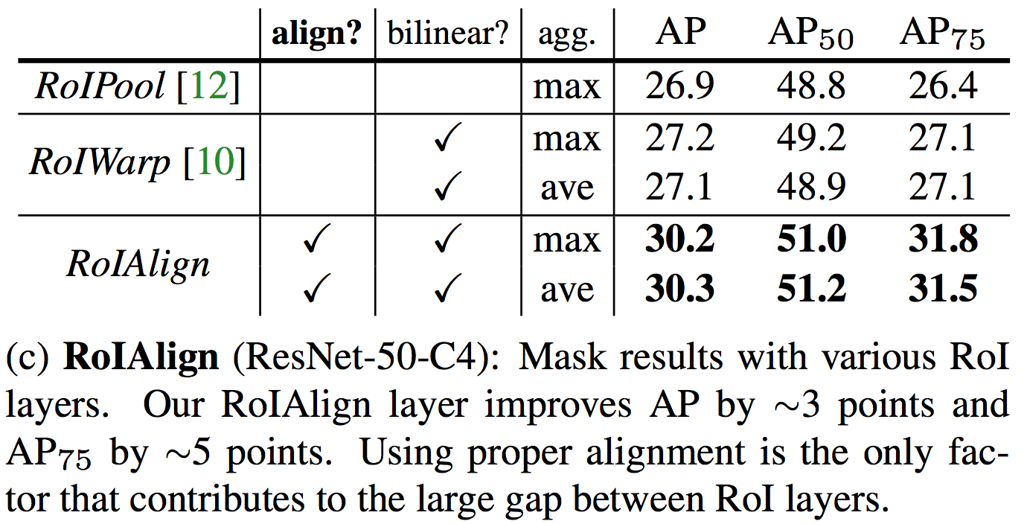
Compare to RoIPool
Preserve alignment or not?
+20% relative at high IoU
Notes:
If we compare the proposed RoIAlign operation to RoIPool, we can determine that the preserving alignment and not quantizing the bins is crucially important to mask AP

Slide 21
Compare to RoIPool
Quantization breaks pixel-to-pixel alignment
😖
😖
Snapped RoI
Original RoI
RoIPool coordinate
quantization
😖
Notes:
In summary, quantizing the original proposal RoI is a crucial mistake for fine-grained tasks like predicting masks

Slide 22
Mask R-CNN
Per-image computation
Per-region computation for each $r_{i}∈r(I)$
Softmax clf.
$f_{I}$ = FCN$(I)$
MLP
Box regressor
$$I:$$
RoIAlign
Mask FCN
RPN($f_{I})$
Notes:
That brings us to the last second new component in Mask R-CNN, which is a task specific head for mask prediction

Slide 23
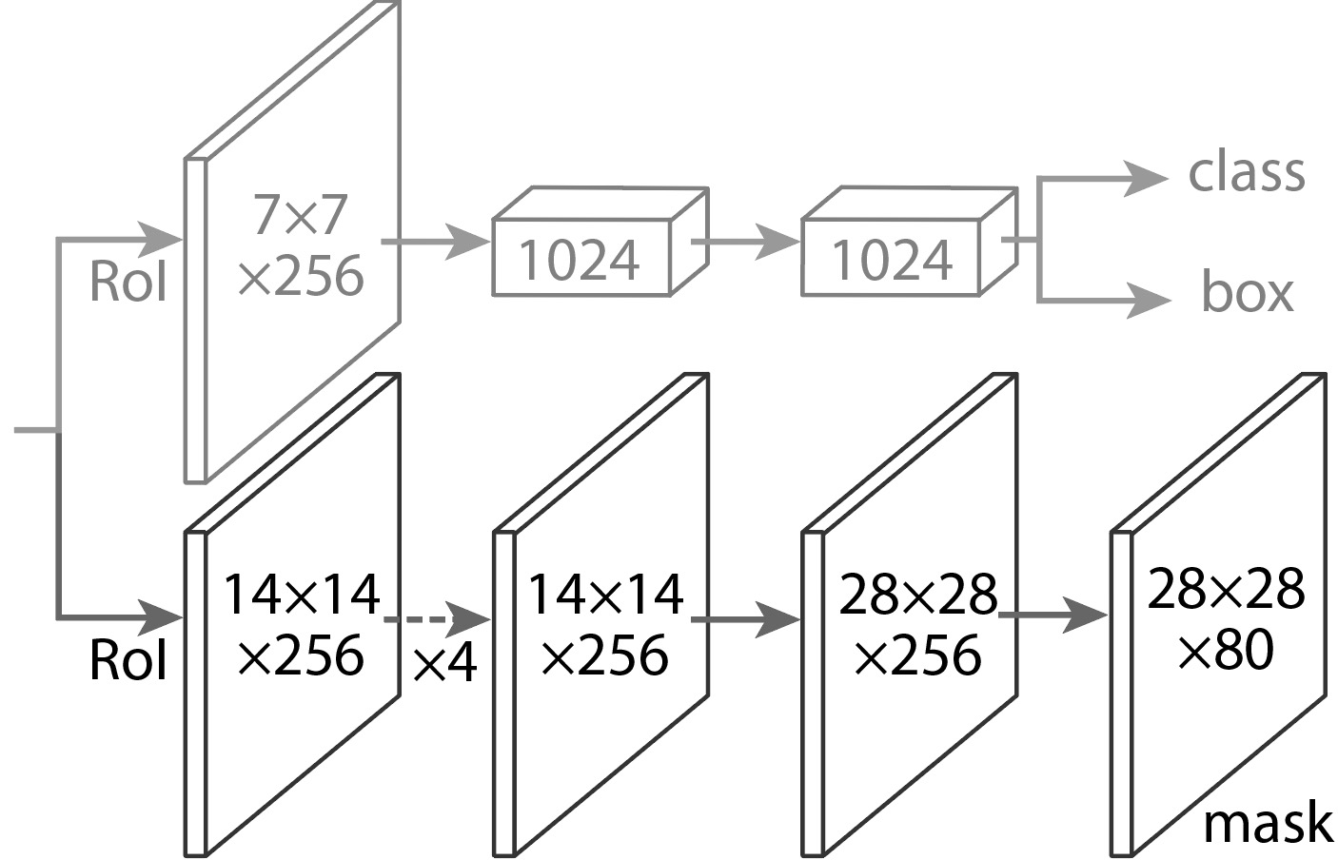
Mask Head (on each Proposal)
Task specific heads for …
Object classification
Bounding box detection
Instance mask prediction
Standard Fast/er R-CNN head
RoIAlign
transformed
features
RoIAlign
Notes:
Recall that from Fast and Faster R-CNN, we have a head that operates on the RoIAlign features in order to do object classification and box regression

Slide 24
Mask Head (on each Proposal)
Task specific heads for …
Object classification
Bounding box detection
Instance mask prediction
Per-proposal FCN predicts instance masks
RoIAlign
transformed
features
RoIAlign
Conv3x3 * 4
ConvTranspose
Conv1x1
Notes:
Now we add a new head, which operates on the RoIAlign features
Since mask prediction is a spatial task, this head is fully convolutional and uses a combination of conv layers and convtranspose to eventually predict a 28x28 mask

Slide 25
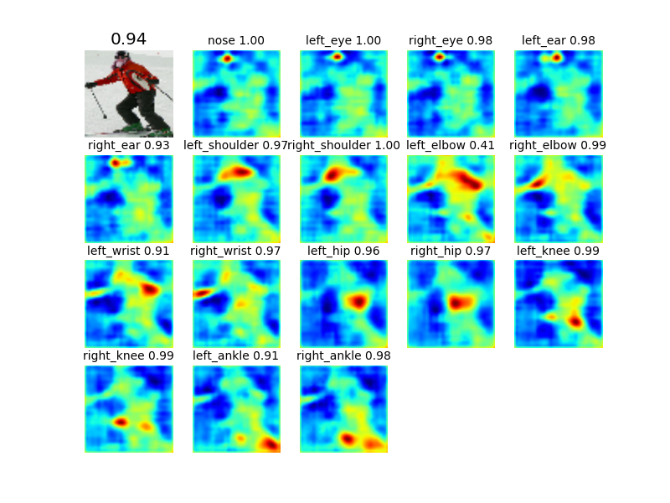
Mask R-CNN: Extension to 2D Human Pose
Per-image computation
Per-region computation for each $r_{i}∈r(I)$
Softmax clf.
$f_{I}$ = FCN$(I)$
MLP
Box regressor
$$I:$$
RoIAlign
Mask FCN
RPN($f_{I})$
Pose
FCN
Notes:
Finally, as an extension it’s possible to also use the same idea to predict 2D pose by simply adding another output head

Slide 26
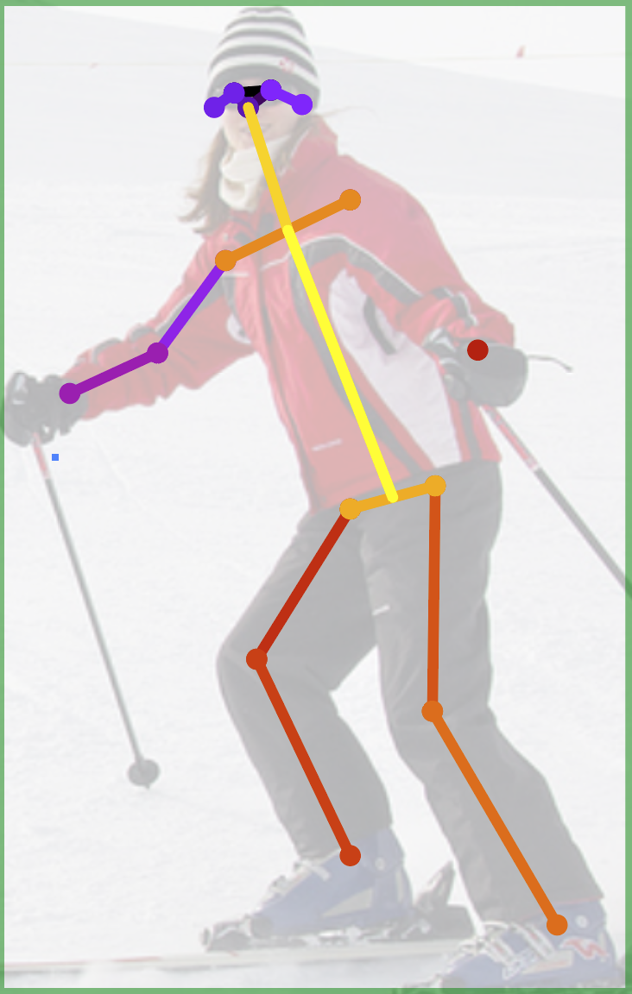
Pose Head
x17
(Not shown: Head architecture is slightly different for keypoints)
keypoints
17 keypoint “mask”
predictions shown as heatmaps with OKS scores from argmax positions
Add keypoint head (28x28x17)
Predict one “mask” for each keypoint
Softmax over spatial locations (encodes one keypoint per mask “prior”)
Notes:
The idea is to treat predicting the location of each of the 17 keypoints as a mask prediction problem where the ground truth mask is one-hot

Slide 27
Mask R-CNN: Training
Same as “image centric” Fast/er R-CNN training
But with training targets for masks
Notes:
In the interest of time, I will skip over most of the details of training other than to say that Mask R-CNN is trained in the same way as Faster R-CNN, but with the addition of training targets for the masks

Slide 28
Example Mask Training Targets
Image with training proposal
28x28 mask target
Image with training proposal
28x28 mask target
Notes:
Here’s an example training image with four training targets
Each training proposal is matched to a ground truth object and then a target mask is asigned to it

Slide 29
Mask R-CNN: Inference
1. Perform Faster R-CNN inference
Run backbone FCN
Generate proposals with RPN
Score the proposals with clf. head
Refine proposals with box regressor
Apply NMS and take the top K (= 100, e.g.)
2. Run RoIAlign and mask head on top-K refined, post-NMS boxes
Fast (only compute masks for top-K detections)
Improves accuracy (uses refined detection boxes, not proposals)
Notes:
Inference is performed as a two stage cascade for efficiency
First standard Faster R-CNN inference is run. This involves running the backbone FCN, generating RPN proposals, scoring the proposals with the classification head and refining them with the box regressor
Then non-maximum suppression is applied and the top, say 100, detections are passed to the second stage
In the second stage, RoIAlign is run on these top detections and then they are passed to the mask head to compute the final mask predictions

Slide 30
Mask Prediction
28x28 soft prediction from Mask R-CNN
(enlarged)
Soft prediction resampled to image coordinates
(bilinear and bicubic interpolation work equally well)
Final prediction (threshold at 0.5)
Validation image with box detection shown in red
Notes:
Since the masks are predicted at 28x28 pixels, as a final step they are mapped back into the image space by resampling into the image coordinate frame and then thresholding the soft prediction at 0.5.

Slide 31
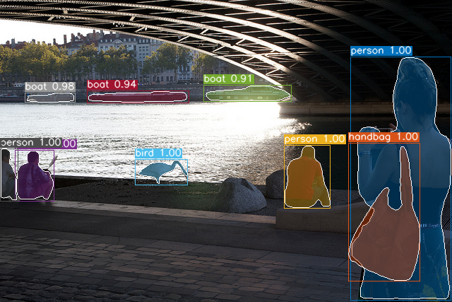
Mask Prediction
28x28 soft prediction from Mask R-CNN
(enlarged)
Soft prediction resampled to image coordinates
(bilinear and bicubic interpolation work equally well)
Final prediction (threshold at 0.5)
Validation image with box detection shown in red
Notes:
Since the masks are predicted at 28x28 pixels, as a final step they are mapped back into the image space by resampling into the image coordinate frame and then thresholding the soft prediction at 0.5.

Slide 32
Quantization breaks pixel-to-pixel alignment
😖
😖
Snapped RoI
Original RoI
RoIPool coordinate
quantization
😖

Slide 33
Mask Prediction
28x28 soft prediction
Resized soft prediction
Final mask
Validation image with box detection shown in red
Notes:
Here’s another example

Slide 34
Mask Prediction
28x28 soft prediction
Resized Soft prediction
Final mask
Validation image with box detection shown in red
Notes:
And a final example

Slide 35
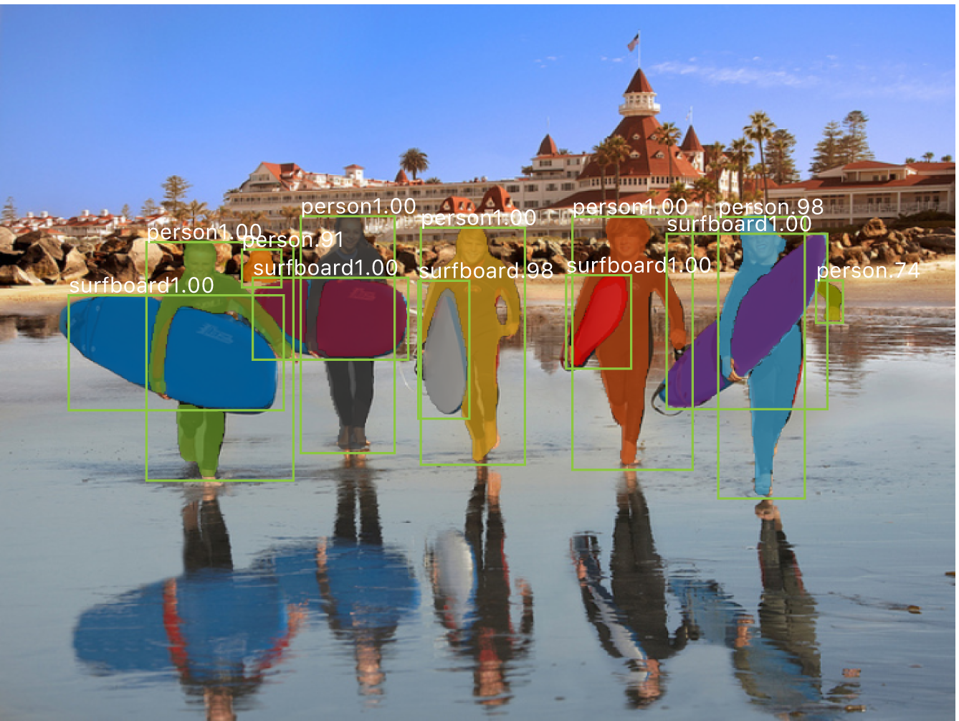

Slide 36
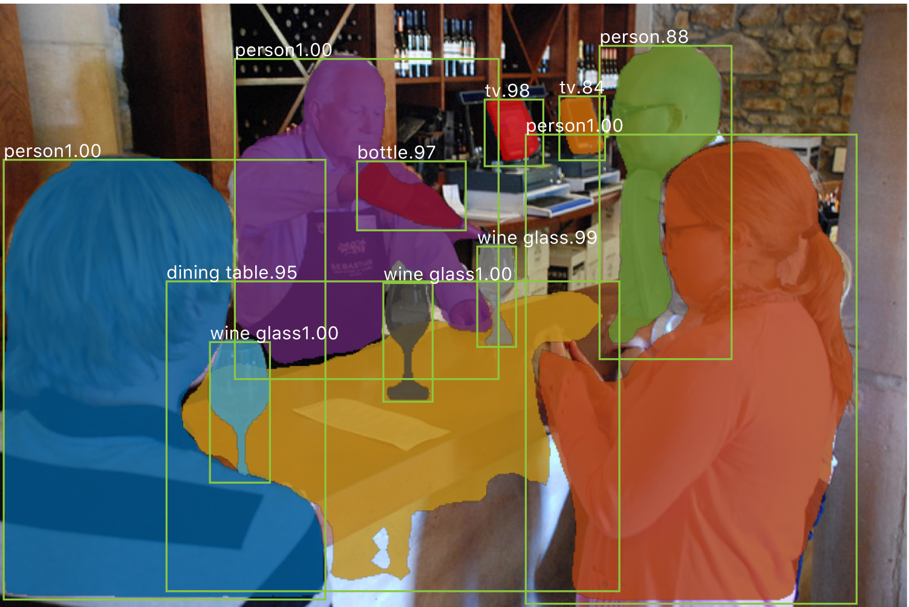

Slide 37
